Slide 1
Do overgrazing alter soil Microbial community?
A case study in Spain
Peter Chien
09/25/2023

Slide 2

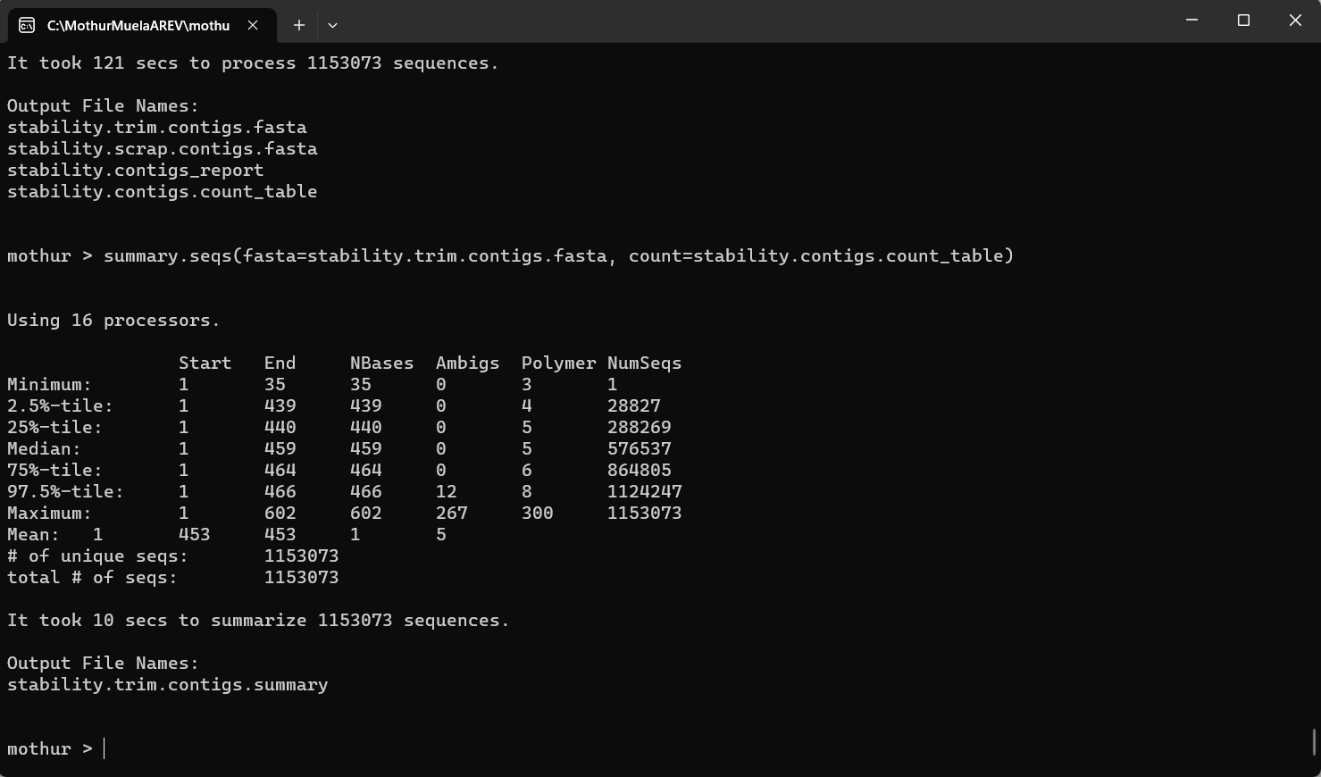
Software for Sequencing - Mothur

Slide 3
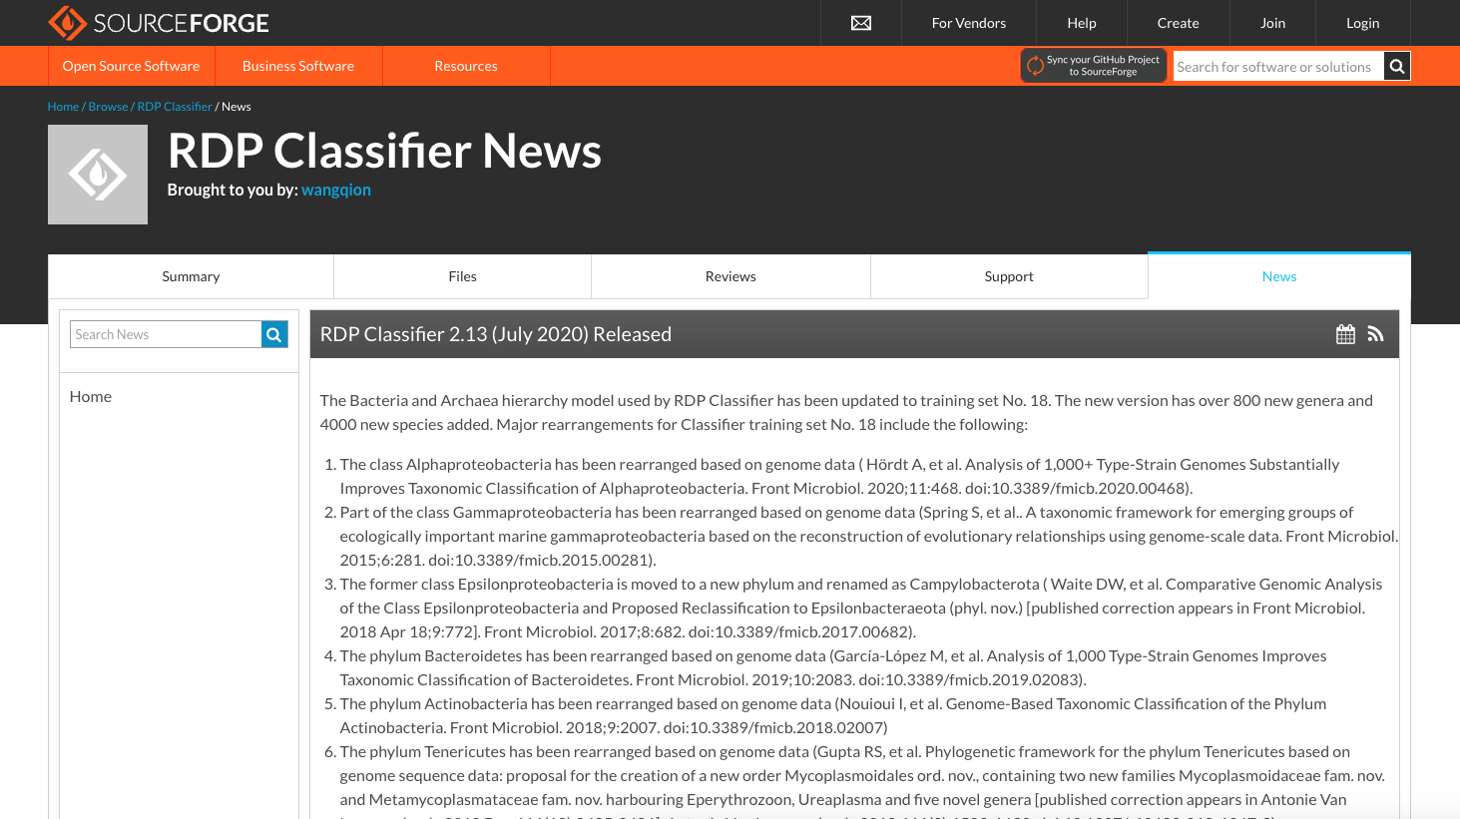
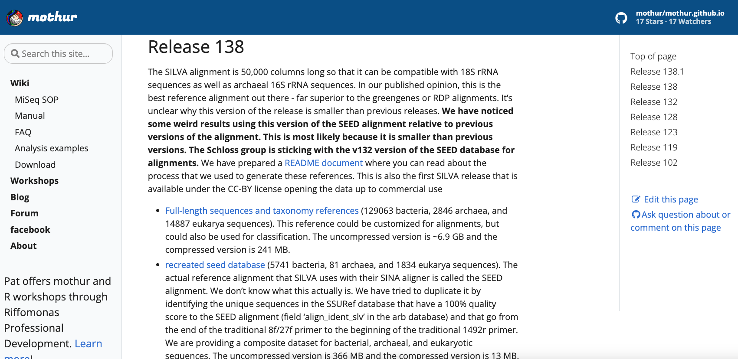
Reference Data Input
RDP recent database for bacteria and archaea hierarchy model
SILVA data for sequence alignment

Slide 4
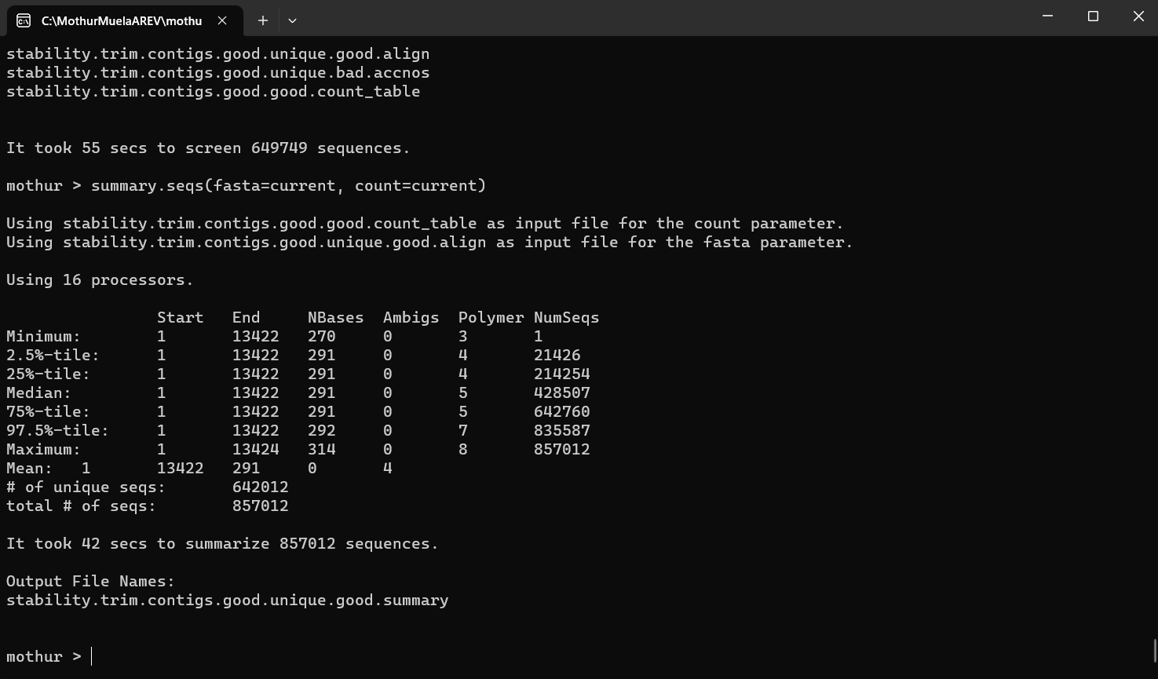
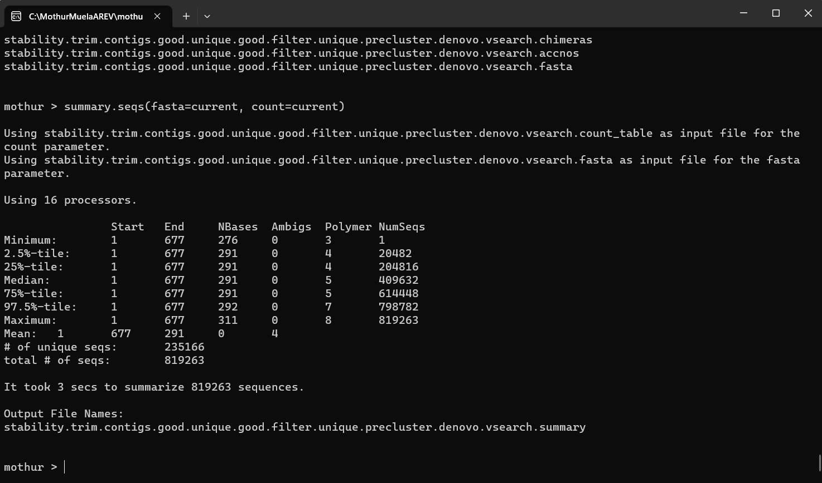
Run the Sequence…
Setup output file, Pair forward and inverse data, Trim sequence
Screen sequence, Unique sequence
Align our sequences to the reference alignment
Filter Sequence, Unique sequence
Pre-cluster, Chimera-vsearch, Classify, Remove lineage
Organize Data, Perform some analyses
Let me know if you want me to exemplify…
we will move to my other laptop

Slide 5
Note
So far bacterial data only, for Muela and some forest locations in Quintos

Slide 6
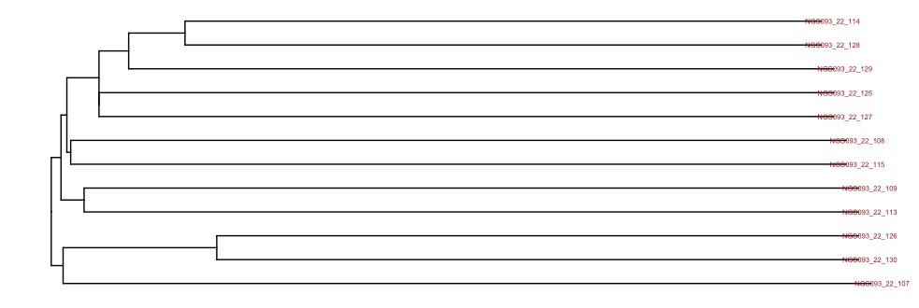
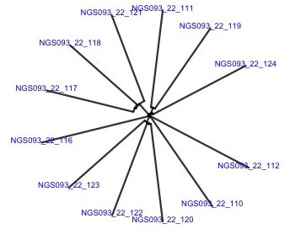
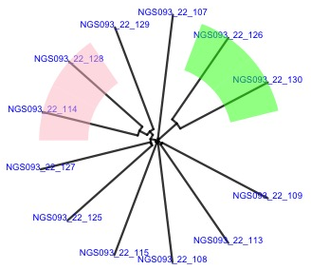
Phylogenic trees - Muela
Overall, samples from control and treatment groups are not separated from each other
Treatment B
Treatment B
Treatment B
Control B
Control B
Treatment A
Control B
Control A
Treatment A
Control A
Control A
Control A
Control B
Control B
Treatment B
Treatment A
Treatment B
Treatment A
Control B
Treatment A
Treatment B
Control A
Control A
Treatment A

Slide 7
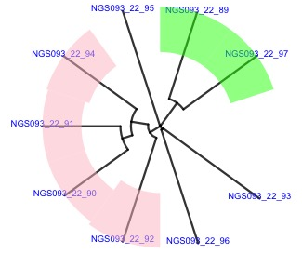
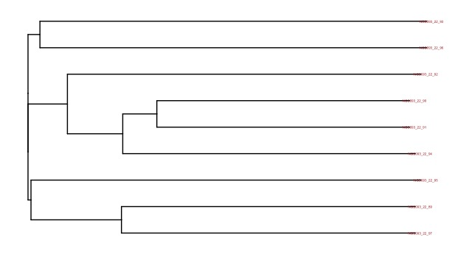
Phylogenic trees – Quintos Forest
Overall, samples from control (Forest C) and treatment groups are not separated from each other
Forest C
Forest A
Forest B
Forest C
Forest A
Forest A
Forest B
Forest B
Forest C

Slide 8
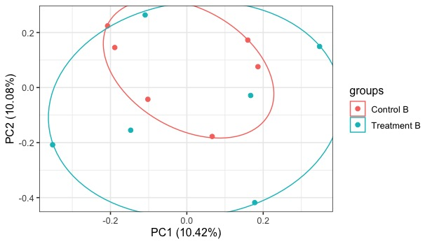
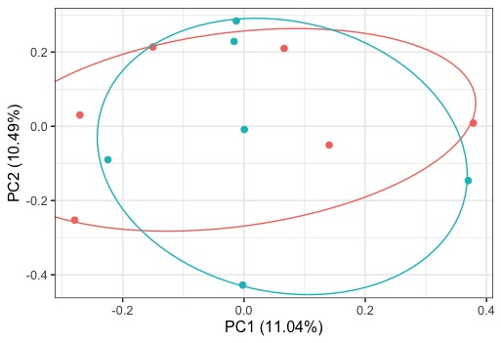
Pcoa plots - Muela
Overall, it is hard to tell control and treatment samples are differentiated.
A
A

Slide 9
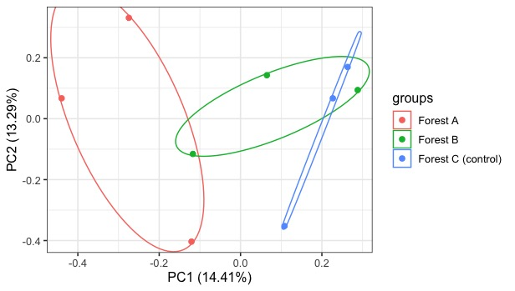
Pcoa plots – Quintos Forest
Overall, groups are more separated in forest settings.

Slide 10
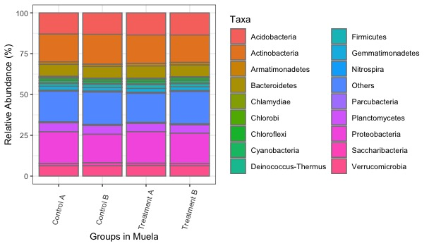
Alpha Diversity - Muela

Slide 11
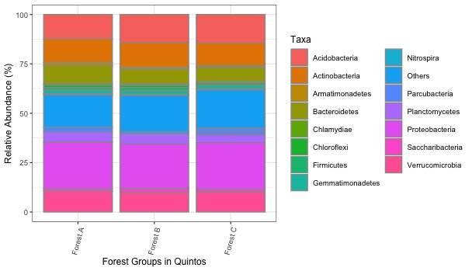
Alpha Diversity – Quintos Forest

Slide 12
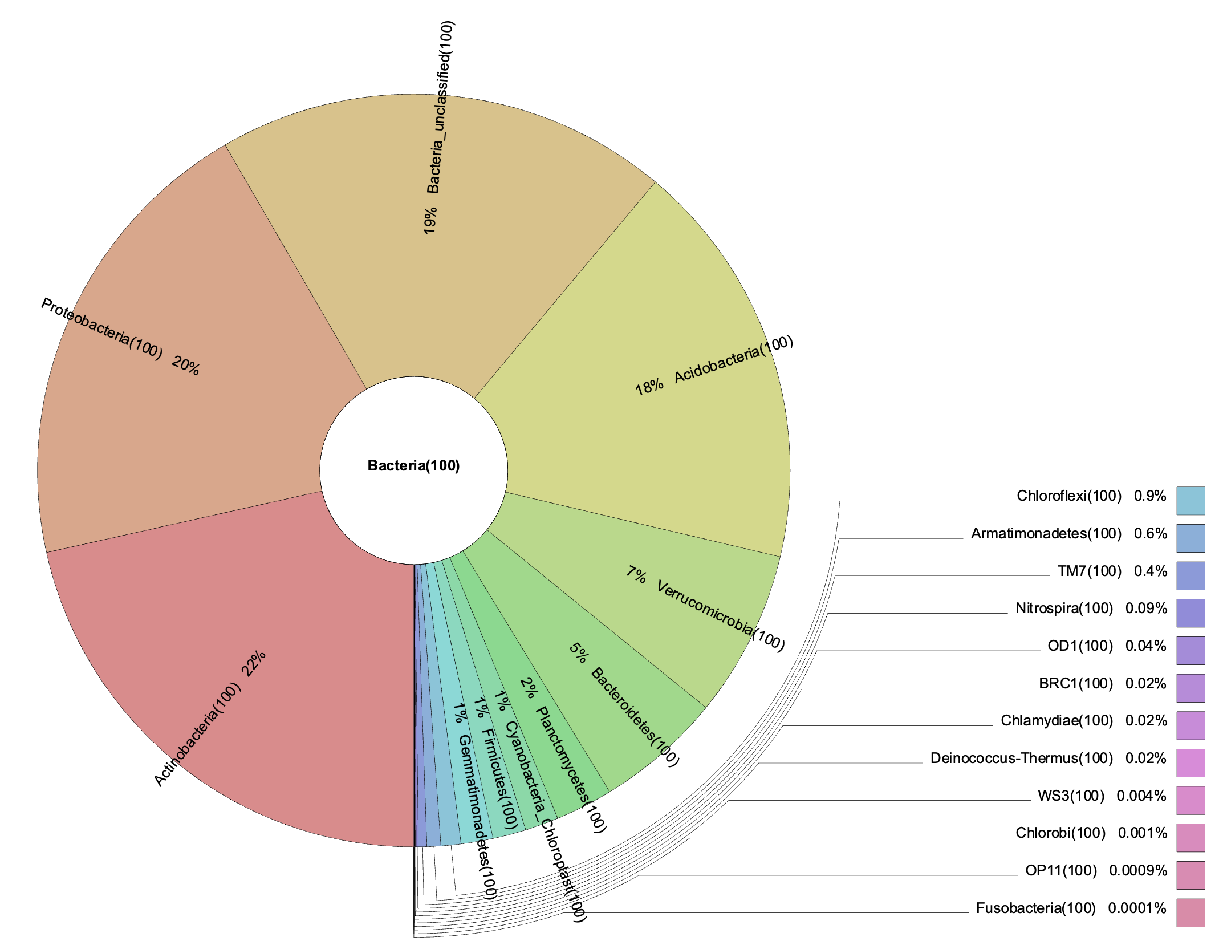
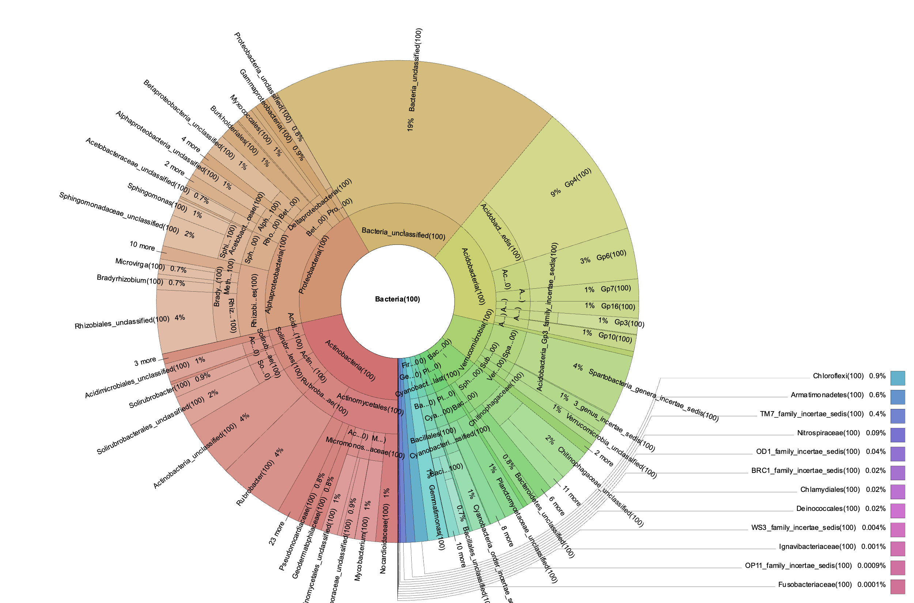
Alternative Figures in Alpha Diversity – Muela A

Slide 13
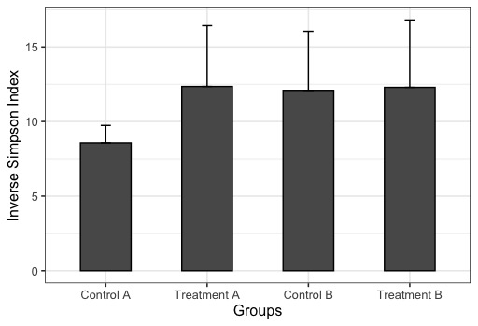
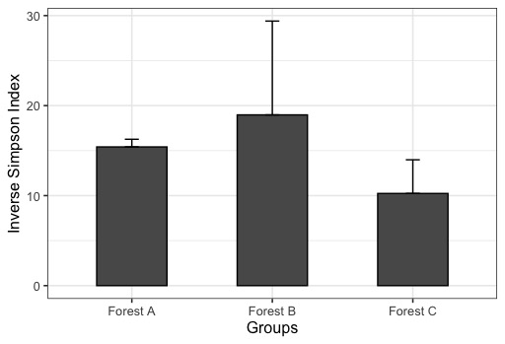
Inverse Simpson Index
Muela
Quintos

Slide 14
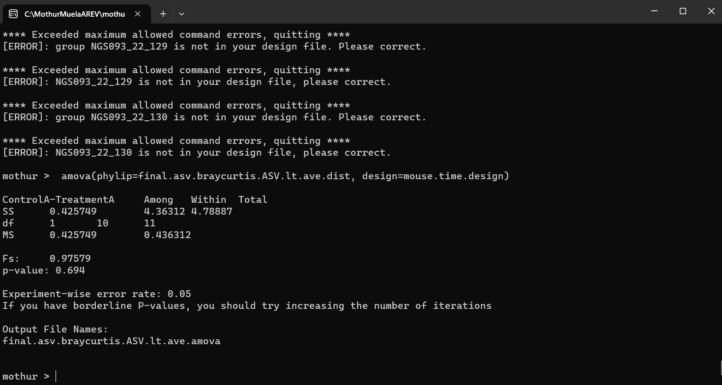
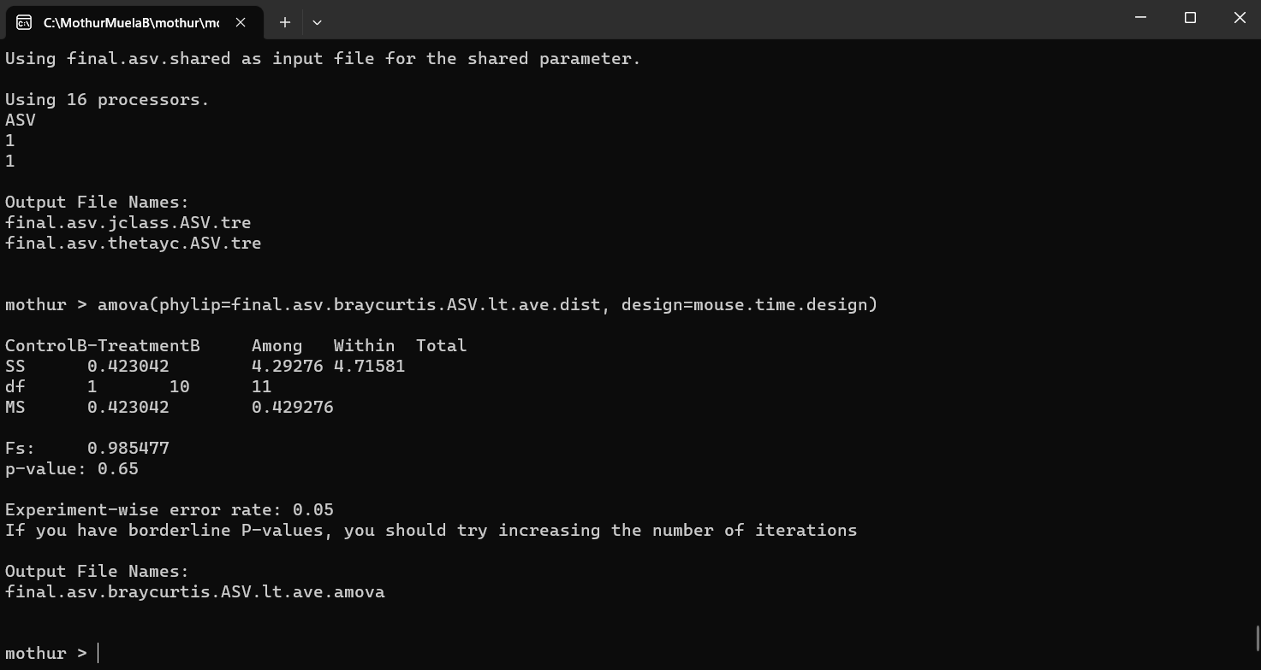
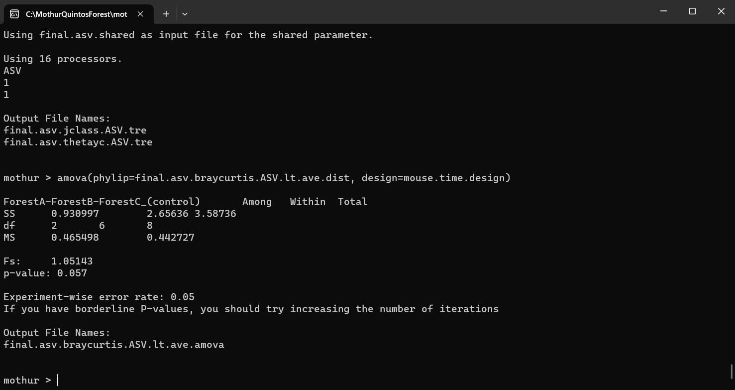
Beta Diversity – amova test
Overall, Control and Treatment Groups are not statistically different
Muela A
p-value = 0.69
Muela B
p-value = 0.65
Muela B
p-value = 0.06

Slide 15
My analyses
I used ASV-based analysis, which is the same as OTU-based analysis, but at a different taxonomic scale
My laptop does not perform well in traditional approach, which uses dist.seqs and cluster
All the Figures can be improved in its arrangement, legend, and resolution
Are these the things you expected?
Error rate

